Slide 1


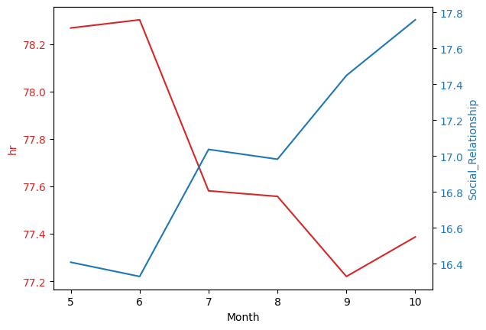
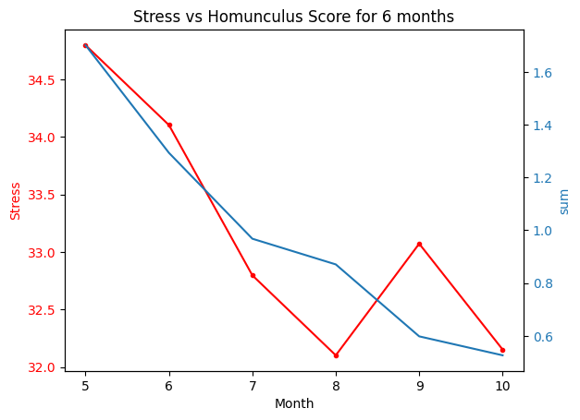
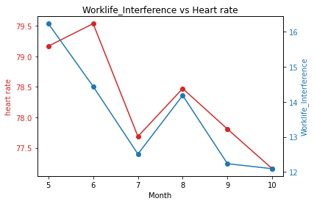
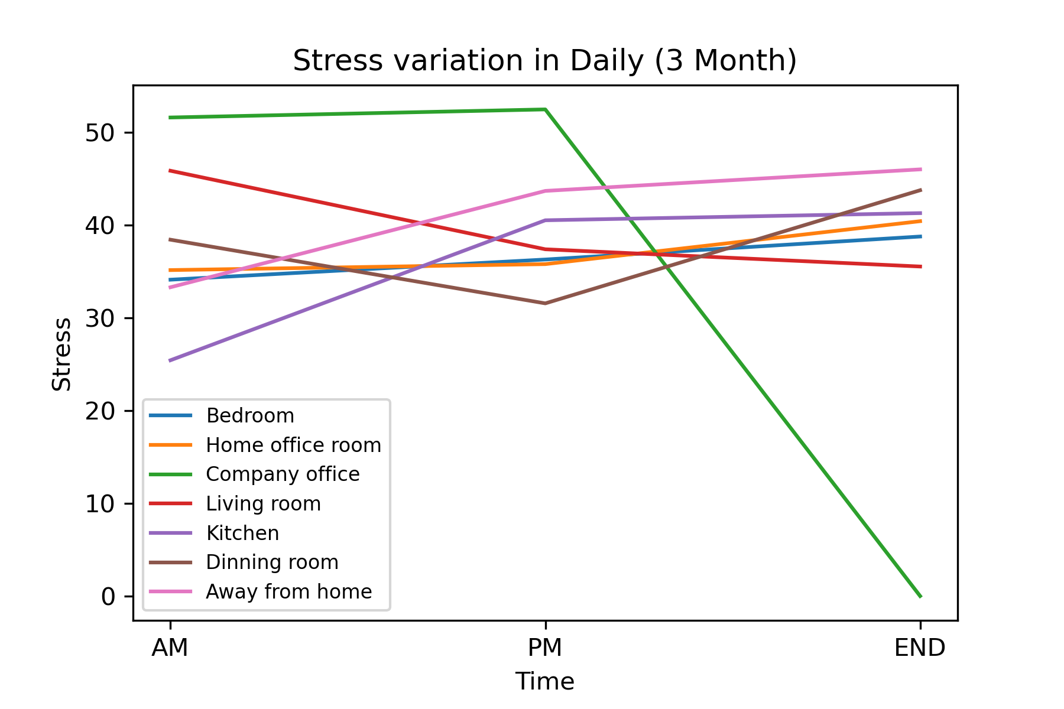
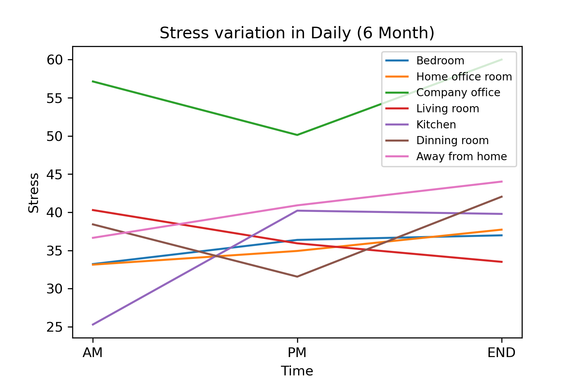







Working from the Home Environment & Well-Being Study Data
Team 1 - Vani Singhal, Jessica Woo, Ming-Han Hsieh, Wei Tse Kao - M. S Computer Science
PROJECT SUMMARY
The project focuses on assessing the physical, cognitive, and mental effects of a remote work environment by collecting data from 70 participants over 6 months using a Garmin watch and an Ecological Momentary Assessment app. The Garmin watch collected physical health data and the app collected survey data. Our goal was to find potential correlations between the Garmin data and survey data and analyse the change from 3 months to 6 months.
PROJECT RESULTS / DELIVERABLES
Answering Hypothesis
We tested 5 hypotheses and only 2 were valid. Our key findings are:
Participants age will negatively correlate with financial and material stability.
Participants who take an avg of 4 breaks/day will positively correlate with productivity scores and report lower discomfort at 1-month compared to 6-month data.
Participants with a data entry job reported lowest mental health score compared to participants in healthcare.
The pressure level of all locations in daily time only change slightly from “3 Month data” to “6 Month data”.
EXTENDED PROJECT RESULTS / DELIVERABLES
Cleaning Garmin Data
We used different methods for each data type to process 0 values before we grouped the data by each day.
Finding Relationships:
We used the Pearson Correlation Coefficient to calculate the correlation between the Garmin data and each type of survey data (i.e. Flourishing Scale survey, E-work life, etc.). Here are some great examples of our findings:
CLIENTS OR MENTORS
Client - KAREN JACOBS
Associate Dean, Digital Learning and Innovation Sargent College
REFLECTIONS
We learned how to analyze real-world data and how to use the tools we learned in class in real-world applications.
TECH STACK / PROCESSES

